Slide 1

SIMPLE CHATBOT
An interactive PROGRAM SIMULATOR

Slide 2

CHATBOT COMPONENTS
Python Library
Automated Responses
ML Algorithm
Train Data
A chatbot is a Program that simulates a conversation between a user and a computer
To build a chatbot we need an input, a tool, methodology and a desirable output.
In a retrieval based model, a chatbot uses some heuristic to select a response from a library of predefined responses.

Slide 3
Technical Concepts
NLTK : Natural Language Tool Kit
Remove Noise & Stop words
Stemming / Lemmatization
Term Frequency
Inverse Document Frequency
TF IDF
Cosine Similarity
Notes:
NLTK an amazing python library to play with natural language. It provides easy-to-use interfaces to over 50 corpora and lexical resources such as WordNet, along with a suite of text processing libraries for classification, tokenization, stemming, tagging, parsing, and semantic reasoning, wrappers for industrial-strength NLP libraries.
Removing Noise i.e everything that isn’t in a standard number or letter. some extremely common words which would appear to be of little value in helping select documents matching a user need are excluded from the vocabulary entirely. These words are called stop words
Stemming is the process of reducing inflected (or sometimes derived) words to their stem, base or root form — generally a written word form. Example if
we were to stem the following words: “Stems”, “Stemming”, “Stemmed”, “and Stemtization”, the result would be a single word “stem”.
Lemmatization: A slight variant of stemming is lemmatization. The major difference between these is, that, stemming can often create non-existent words, whereas lemmas are actual words. Examples of Lemmatization are that “run” is a base form for words like “running” or “ran” or that the word “better” and “good” are in the same lemma so
they are considered the same.
Term Frequency: is a scoring of the frequency of the word in the current document. Inverse Document Frequency: is a scoring of how rare the word is across documents.
TF-IDF is a transformation applied to texts to get two real-valued vectors in vector space
Cosine similarity is a measure of similarity between two non-zero vectors. We obtain the Cosine similarity of any pair of vectors by taking their dot
product and dividing that by the product of their norms. That yields the cosine of the angle between the vectors

Slide 4

Import required Libraries
01
02
STEP
STEP
Text Data Pre Processing
05
Greeting Response
03
STEP
STEP
Keyword Matching to Query
04
Robo Response to User
STEP

Slide 5
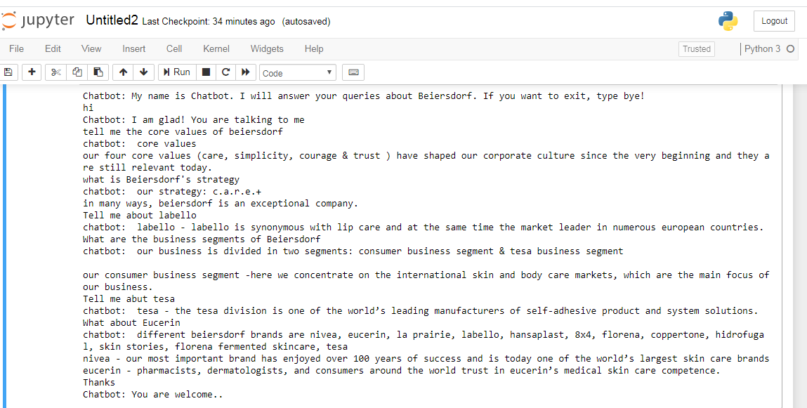
CHATBOT RESPONSE

